Slide 1


Phonics and Early Reading
Staples Road Primary School
Notes:
‹#›

Slide 2

What is Phonics?
Phonics is a way of teaching children how to read and write. It helps children hear, identify and use different sounds that distinguish one word from another in the English language.

Slide 3
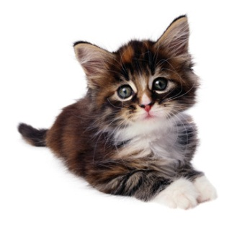
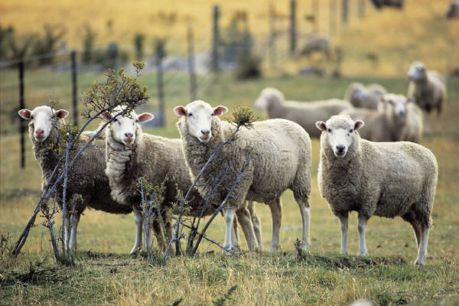
What is a phoneme?
It’s the smallest unit of sound...
How many sounds?
c a t
sh ee p
What is a grapheme?
It’s how that sound is written down.
s m t h a oo igh ck
• • •
•
Notes:
‹#›

Slide 4
What does a Phonics lesson look like?
Revisit/review | Flashcards to practice phonemes learnt so far.
Teach | Teach new phoneme ‘air’
Practice | Buried treasure air, zair, fair, hair, lair, pair, vair, sair, thair
Apply | Read captions: The goat had a long beard and hair. The stairs went up to the funfair

Slide 5
The first sounds…
We teach the sounds not the letter names.
The first set of sounds we teach are:
s a t p i n m d
Notes:
‹#›

Slide 6
Making words
Once children know the first 8 sounds we can start reading and writing words.
s a t p i n m d
What words can you make?
Notes:
‹#›

Slide 7

Where it gets a bit tricky…
There are around 44 phonemes to teach in total.
Some of these phonemes are made up of more than one letter including…
ai as in rain
oa as in boat
igh as in night
Notes:
‹#›

Slide 8
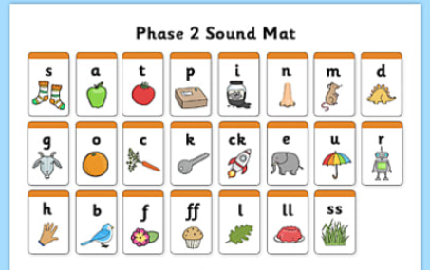

Slide 9
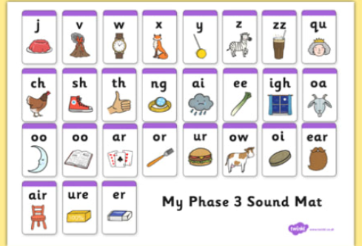

Slide 10
Where it gets even more tricky…
There are around 120 graphemes to teach in total.
There is more than 1 way of representing many of the phonemes including…
ai in rain ay in May a-e in cake
ei in eight ey in they
There is more than one way of saying many of the graphemes including…
ch in chat ch in school ch in chef
Notes:
‹#›

Slide 11
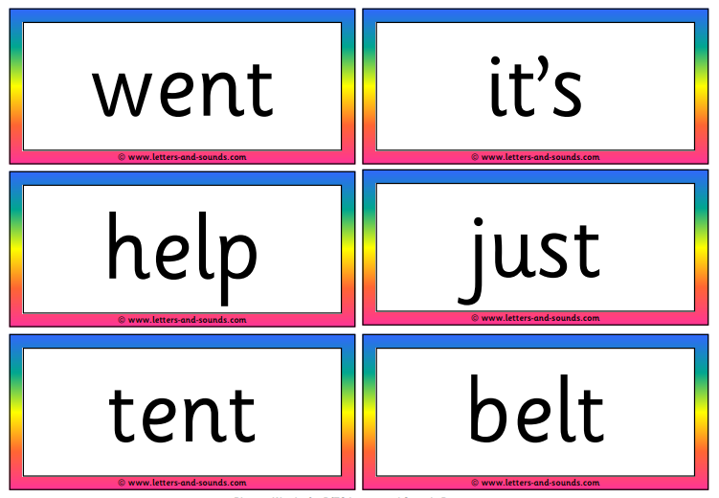
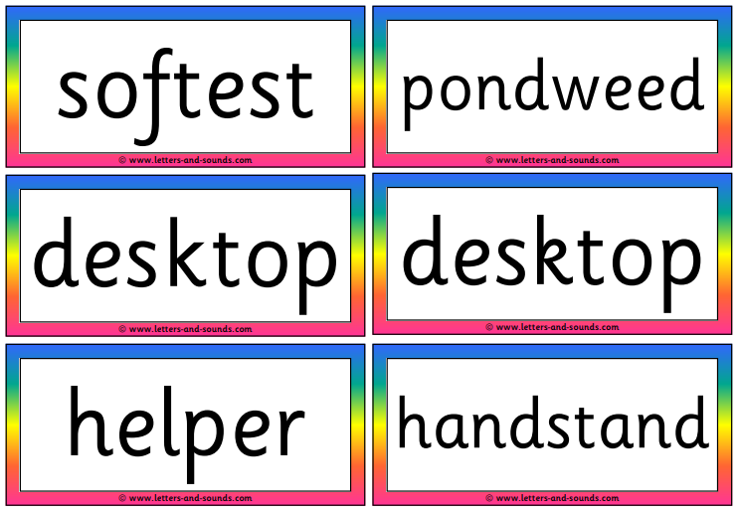
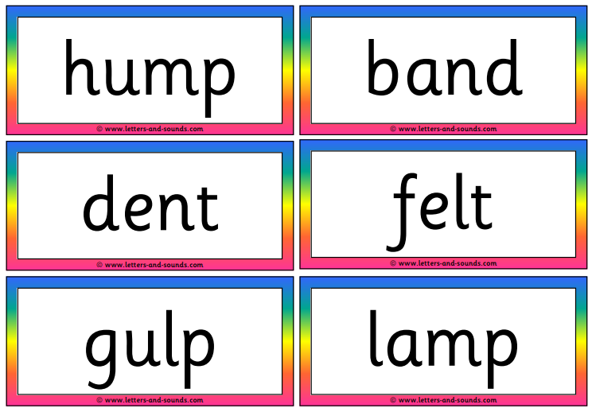
Phase 4
In Phase 4, no new graphemes are introduced. The main aim of this phase is to consolidate the children's knowledge and to help them learn to read and spell words which have adjacent consonants, such as trap, string and milk.
This is when we would encourage the use of blending consonants eg. str dr fr cr pl

Slide 12
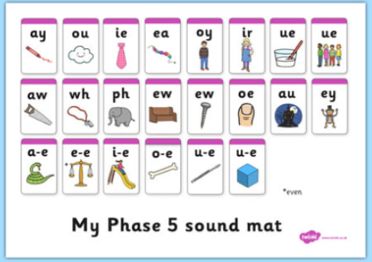

Slide 13
Phase 5
This is where we look at the alternative grapheme used for sounds already taught in phase 3
ai 🡪 ay er, ur 🡪 ir
ow 🡪 ou oo 🡪 ue, ew
igh 🡪 ie or 🡪 aw, au
ee 🡪 ea oa 🡪 oe
oi 🡪 oy f 🡪 ph
Notes:
‹#›

Slide 14
Sounds are important
Your child will be taught how to pronounce the sounds (phonemes) correctly to make blending easier
Sounds should be sustained where possible (eg, sss, mmm, fff)
‘uh’ sounds after consonants should be reduced where possible (eg, try to avoid saying ‘b-uh’, ‘c-uh’)
https://video.link/w/UwsFc
Notes:
‹#›

Slide 15
Phase 6
The focus is on learning spelling rules for suffixes.
-s -es -ing -ed
-er -est -y -en
-ful -ly -ment -ness
Notes:
‹#›

Slide 16
Tricky words (Common exception words)
Your child will also learn several tricky words; those that cannot be sounded out
eg: the, to, I, go, no
These need to be learnt as sight vocabulary, so the children know them off by heart. Try to discourage your child from sounding out these words to either read or write them
Use letter names when learning how to write or make tricky words
Notes:
‹#›

Slide 17
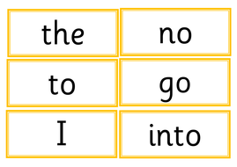
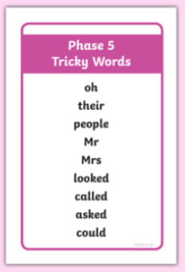
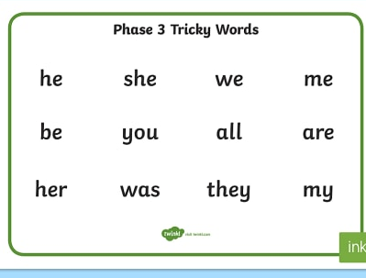
Notes:
‹#›

Slide 18
How can I help?
Play ‘I spy’ something beginning with or something that rhymes with
Play with magnetic letters or letter cards
eg: r-a-n = ran blending for reading
ran = r-a-n segmenting for spelling
Play games with the tricky words like snap, pairs and bingo
Sort objects into groups that start with the same sound
Practise letter formation in sand, flour, paint…
Practise sounds from that week as often as possible
Daily reading, to apply sounds.
Practising tricky and high frequency words everyday.
Notes:
‹#›

Slide 19
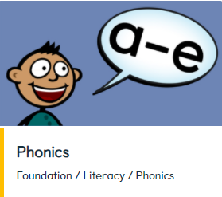
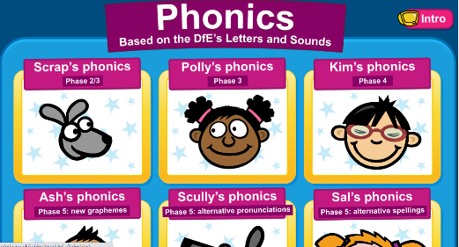
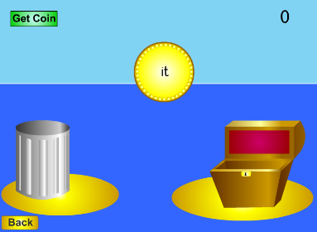
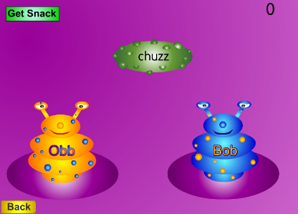
Espresso at home
Log in: student12165
Password: staples
https://app.discoveryeducation.co.uk/learn/channels/channel/88a51a48-587e-4fef-af49-b069191cdd77?embed=false&embed_origin=false
Letters and sounds website
http://www.letters-and-sounds.com
Phonics Play
log in: staples01
password: phonics
https://www.phonicsplay.co.uk

Slide 20
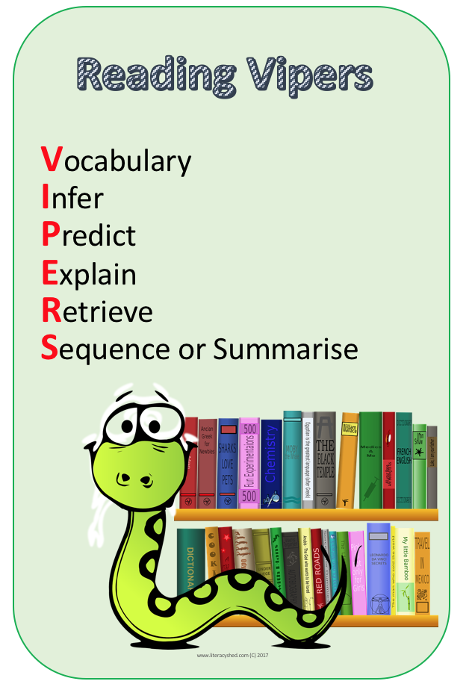
Notes:
‹#›

Slide 21
What is the Year 1 Phonics Test
It was introduced in 2012 as part of a policy to strengthen phonics teaching and emphasise the synthetic and systematic approach.
It normally takes place in June and is administered on a one to one basic with a familiar adult.
During the screening, children will be asked to read a list of 40 words to check their grapheme recognition and decoding skills

Slide 22
What is the Year 1 Phonics Test
The words are made up of real and non-words (pseudo words)
Reading non-words can act as a useful tool to check whether the children are secure in their phonic knowledge and can apply it to read any word.
It usually takes about 10 minutes but there is no time limit.
Each year the pass score isn't announced until after the check has been administered.

Slide 23
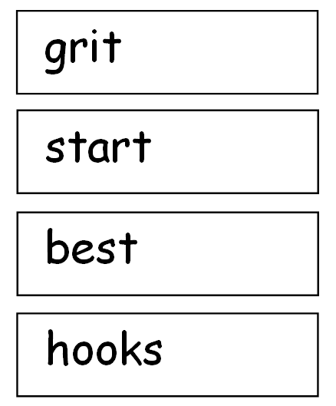
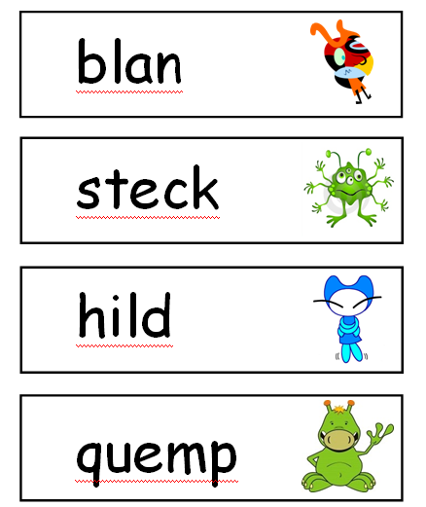
Year 1 Phonics Test
Notes:
‹#›

Slide 24
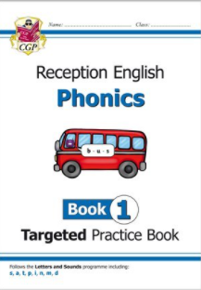
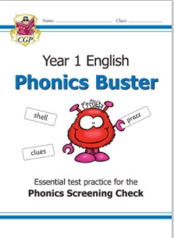
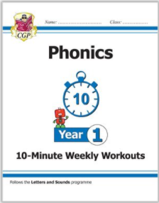
Extra activities for home…
You can purchase these books for around £2 from the school. It will be available on scopay and given to the children to bring home.

Slide 25

Thank you for your time today.
If you have any questions, your child’s teacher will always be happy to help.
Notes:
‹#›

